Slide 1

Traffic Signal Construction and Inspection in Pennsylvania
Chapter 4:
Materials and Products
Notes:
Welcome to Module 4 of the Traf Signal Constr & Inspect in PA e-learning course. In this module, we will discuss a variety of materials and products.

Slide 2
General
106.01 GENERAL—Use material complying with the requirements of these specifications. At the pre-construction conference, submit a list of material to be sampled and tested by the Contractor and a list of material to be sampled and tested by the Department.

Slide 3
Acceptance of Traffic Signal Materials
Manual Section 4.1
Acceptance of the following material on construction projects by certification is based on their appropriate Publication 408 (Standard Specifications) reference
Item | Publication 408 Reference
Traffic Signal Support, Mast Arm | Section 951.2
Traffic Signal Support, Strain Pole | Section 951.2
Traffic Signal Support, Pedestal | Section 951.2
Controller Assembly | Section 951.2
Traffic Signal Systems and Communication | Section 953.2
Electrical Distribution System | Section 954.2
Signal Heads | Section 955.2
Detectors | Section 956.2
Traffic Signals (Manufactured Materials) | Section 1104
Temporary Traffic Control Signals | Section 1124

Slide 4
Acceptance of Traffic Signal Materials
All traffic signal materials should be listed on Form CS-201
The Districts review and check the form, except for the structural support poles
In accordance with Department specifications, the engineer may accept certification of materials in lieu of inspection and testing

Slide 5
Traffic Signal Product Approvals
Manual Section 4.2
The Bureau of Maintenance and Operations (BOMO) issues a Certificate of Approval (COA) to manufacturers authorizing the sale of specific electrically-operated traffic signal equipment
Contractors are responsible to tabulate a list of the proposed equipment

Slide 6
Traffic Signal Product Approvals
BOMO also approves standard loadings for traffic signal supports, but shop drawings are submitted and design calculations are required for non-standard loadings

Slide 7
Traffic Signal Product Approvals
Three copies of
  Warranties
  Guarantees
  instruction manuals
  wiring diagrams
  field wiring diagrams
  parts lists

Slide 8

Traffic Signal Product Approvals
  One copy of each should be retained as follows
  Department file
  Municipal file
  Retained in the controller cabinet
  Publication 35, Bulletin 15 information

Slide 9
Bulletin 15 Approval Process
Bulletin 15 Approval Process
  Product Evaluation Application Form (CS-4170)

Slide 10
Bulletin 15 Approval Process
Bulletin 15 Approval Process
  The following entities are eligible to apply for Bulletin 15 approval:
    Manufacturers
    Steel Epoxy Coaters or Galvanizers
    Wood Treaters
    Steel, Aluminum or Timber Fabricators
    Machine Shops
    Paint Shops
    Precast/Prestressed Concrete Producers
    Cement Plants or Terminals
    Pozzolan Providers
    Bituminous Terminals or Refineries

Slide 11
Bulletin 15 Approval Process
Bulletin 15 Listings
  Organized in the format of Publication 408, Specifications

Slide 12
Bulletin 15 Approval Process
Bulletin 15
  Will indicate if a supplier is on a reduced Level of Certification
  Indicate by notation if a product has received either a Provisional Approval or a Conditional Approval

Slide 13
Bulletin 15 Removal Actions
Bulletin 15 Removal Actions
  A manufacturer and/or product(s) may be removed from Bulletin 15
  Refer to manual for list of reasons

Slide 14
Department Shop Drawing Approval
Department Shop Drawing Approval
  Shop drawings are required for all traffic signal supports on each project
  Department has a pre-approval process
  Only need to verify that loading meets contract requirements and matches pre-approved drawings

Slide 15
Catalog Cut Sheets
Manual Section 4.3
General term for a few pages of specifications, instructions, dimensions, etc.
Generally shipped with the product
Generally specific enough to convey any information that might be needed to install or use the product

Slide 16
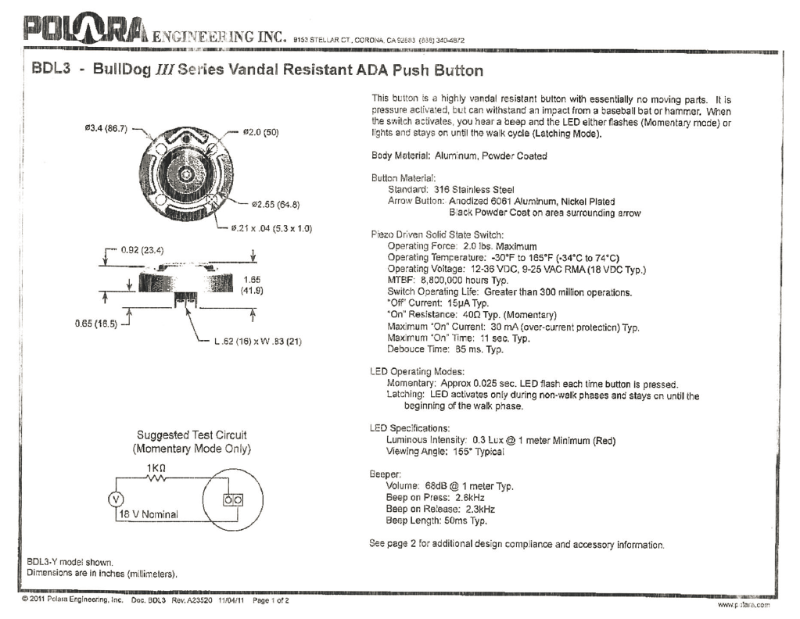
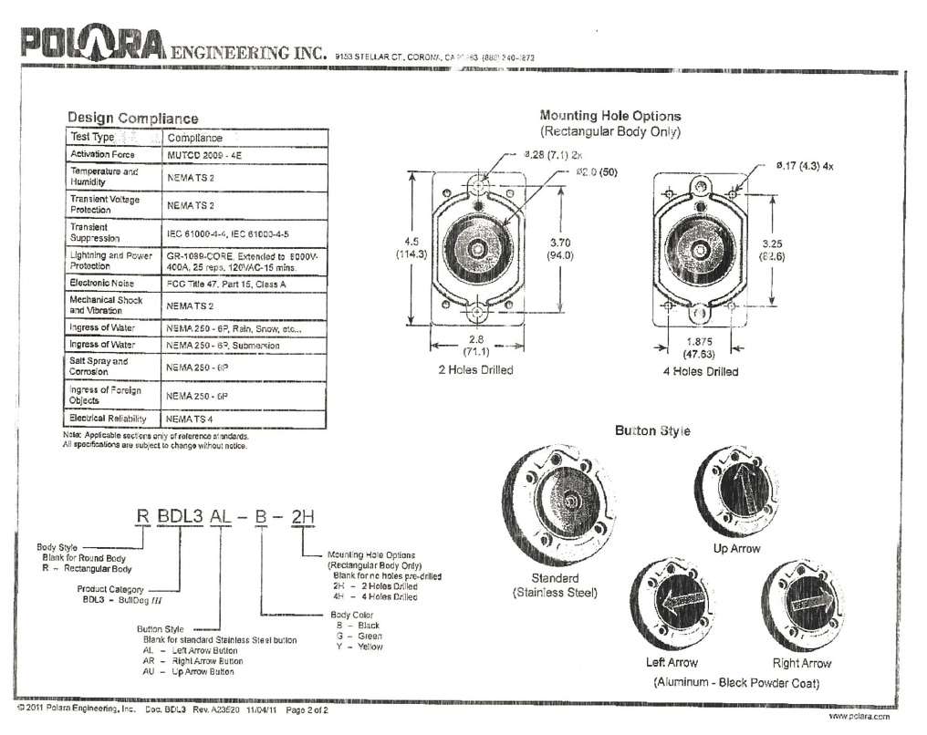
Catalog Cut Sheets
Should include the following information:
  Manufacturer’s make and model number for each piece of equipment
  Quantity of items to be used
  Catalog Cuts may or may not require an Engineer’s seal
    The Department requires an engineering seal for Structural Support submissions
  Either the traffic signal unit or materials unit usually pre-approves the catalog cut sheets on either the CS-201 or directly on the cut sheets

Slide 17
Proprietary Equipment Approvals
Manual Section 4.4
Occasionally, the Department receives requests from municipal officials to specify a particular brand of traffic signal equipment in the special provisions for a project
Attempt to use non-proprietary equipment
Will consider proprietary if in public interest

Slide 18
Testing
Manual Section 4.5
Publication 408 Section | Test Performed
Sec. 1104 | Controller Assembly Shop Test.
Sec. 1104 | Traffic Signal Installation 30-Day Operating Test.
Sec. 952.3(a) | Malfunction Management Unit or Conflict Monitor Function Test.
Sec. 952.3(b) | Time Clock Evaluation.
Sec. 953.3(d) | 30-Day Systems and Communications Test.
Sec. 954.3(j) | Traffic Signal Circuits Test for Short Circuits, Unspecified Grounds, and Resistance to Earth Ground.
Sec. 956.3(a) | Loop Detector Leakage Resistance, Series Resistance, and Inductance Testing.
Sec. 956.3(a) | Earth’s Magnetic Flux Test and Magnetometer Detector Leakage and Series Resistance Test.
Sec. 956 3(a) | Magnetic Detector Leakage and Series Resistance Test.
Sec. 956.3(b) | Pedestrian Pushbuttons Evaluation and Pedestrian Phase Timing Test.
Sec. 953.3(k) | Traffic Signal Communications Test for Short Circuits, Unspecified Grounds, and Resistance to Ground.
Contractor is required to perform tests on various items during the construction of a traffic signal project
Documentation of some test results is required by the contractor, all other tests will have to be documented by the inspector
Following is a tabulation of required tests with references to the section of the specification requiring the test

Slide 19
Rotational Capacity Test
Rotational Capacity Test
  AASHTO M-164 (ASTM A-325)
  A test, “that is intended to evaluate the presence of a lubricant, the efficiency of the lubricant, and the compatibility of assemblies as represented by the components selected for testing.”
  Rotational Capacity Test is included in Publication 19 as PTM 427

Slide 20
High Strength Bolt Inspection Testing
High Strength Bolt Inspection Testing
  This method of test is in accordance with AASHTO M-164 (ASTM A-325), and AASHTO M-253 (ASTM A-490)
  The High Strength Bolt Inspection Test is included in Publication 19 as PTM 429.

Slide 21
Bench Testing
Bench Testing
  “The critical evaluation of a new or repaired component, device, apparatus, etc., prior to installation to ensure that it is in perfect condition.”

Slide 22
Bench Testing
Bench Testing
  Following bench tests may be performed:
    Tested for compatibility with all signal controller assemblies used by the Department
    BIU components in specified tolerances
    MMU components in specified tolerances

Slide 23
Bench Testing
Bench Testing
  Continued:
    TYPE I or II Controller verified for full functionality and manufacturer’s claimed operation
    Loop amplifier verified for full functionality and manufacturer’s claimed operation
    TS-2 Card Rack Counting Loop Amplifier verified for full and manufacturer’s claimed operation
    Field Master Controller verified for full functionality and manufacturer’s claimed operation

Slide 24
Field Testing
Field Testing
  Consist of installing the cabinet component in an actual traffic signal system for the specified testing period to monitor the following:
    Failures for the component
    Relative ease of use for the field personnel
    Overall build quality and expected lifecycle of the cabinet component

Slide 25
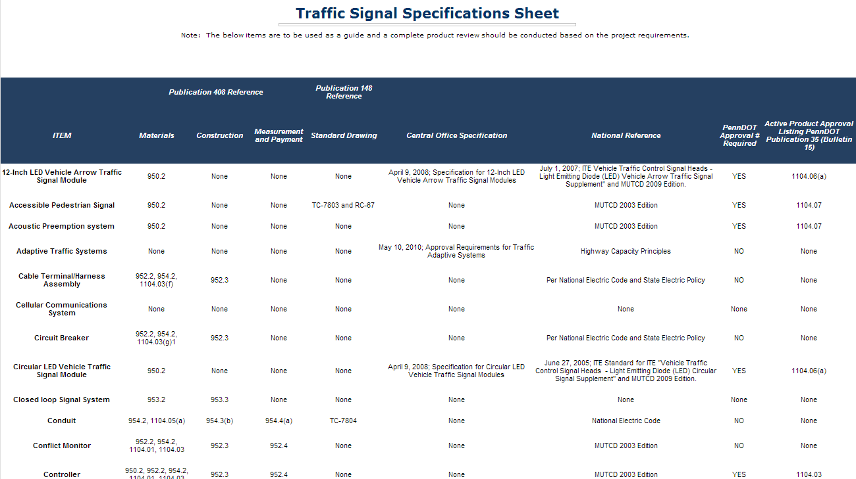
Traffic Signal Specifications Sheet
Manual Section 4.6
PennDOT BOMO maintains a traffic signal specifications sheet for many commonly used traffic signal products

Slide 26
Example
Example:
ITEM | Publication 408 Reference |  |  | Publication 148 Reference | Central Office Specification | National Reference | PennDOT Approval # Required | Active Product Approval Listing PennDOT Publication 35 (Bulletin 15)
 | Materials | Construction | Measurement and Payment | Standard Drawing
Traffic Signal Support – Mast Arm | 951.2,1104.01, 1104.02 | 951.3 | 951.4 | TC-8801 | Publication 149, Chapter 20 | AASHTO 2001 and MUTCD 2009 Edition | YES | 1104.02

Slide 27
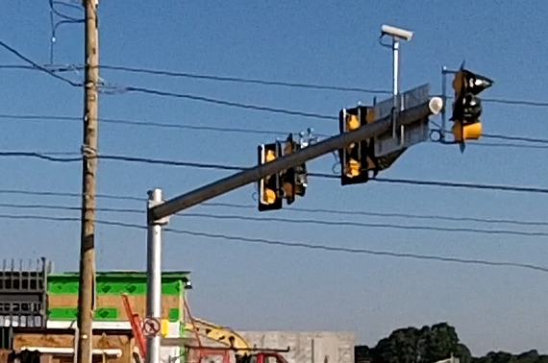
Item
Item: Traffic Signal Support – Mast Arm

Slide 28
Publication 408, Materials
Publication 408, Materials: 951.2

Slide 29
Publication 408, Materials
Publication 408, Materials: 1104.01

Slide 30
Publication 408, Materials
Publication 408, Materials: 1104.02

Slide 31
Publication 408, Construction
Publication 408, Construction: 951.3

Slide 32
Publication 408, Measurement and Payment
Publication 408, Measurement and Payment: 951.4

Slide 33
Publication 148, Standard Drawing
Publication 148, Standard Drawing: TC-8801

Slide 34
Central Office Specification
Central Office Specification: Publication 149, Chapter 20

Slide 35
National Reference
National Reference: AASHTO 2001 and MUTCD 2009 Edition
PennDOT Approval # Required: YES
  Approval number is required for this item, Traffic Signal Support – Mast Arm
  For traffic signal products in Publication 35 (Bulletin 15), the traffic division “Approval Certificate” number is used

Slide 36
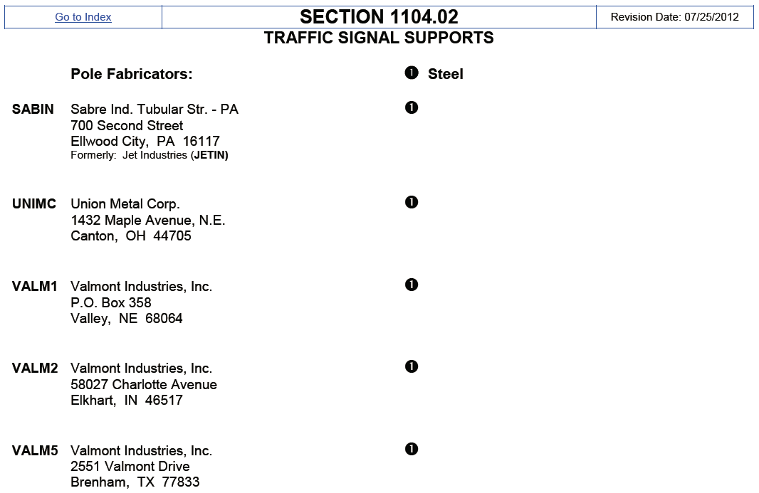
Active Product Approval Listing PennDOT Publication 35 (Bulletin 15)
Active Product Approval Listing PennDOT Publication 35 (Bulletin 15): 1104.02

Slide 37




Are you Awake

Slide 38
Common Electrical Materials
Manual Section 4.7
The following sections describe a variety of the commonly used electrical materials used on traffic signal projects
The list is not all-inclusive and additional materials may be used
This section of the course is intended to be self-paced
  Slides will not advance automatically
  Take time and review materials as desired/necessary

Slide 39
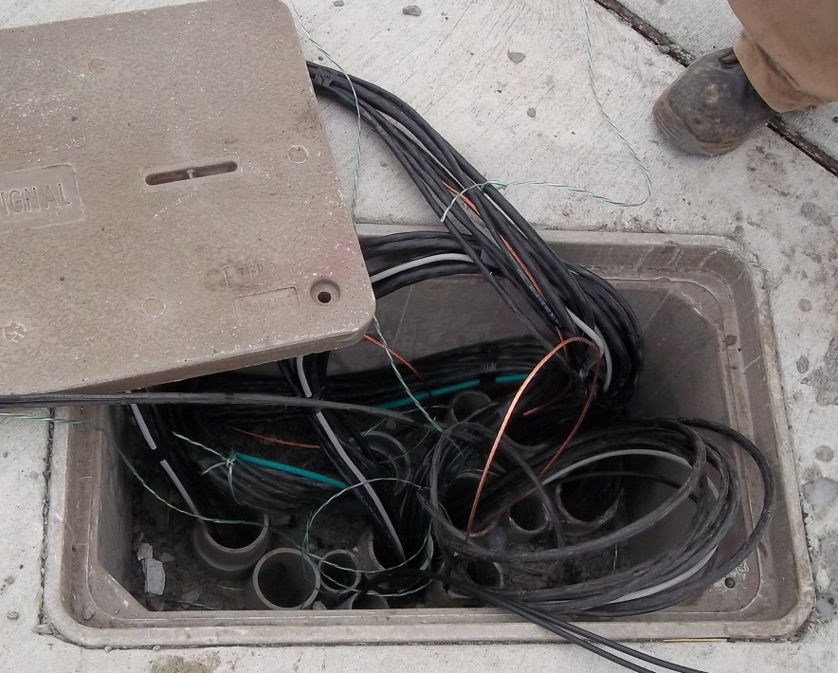
Ground Wire
Ground Wire
  Description: Bare or insulated (green) copper wire, 8 AWG, conforming to ASTM B 3
  Use: Grounding wire for 120V AC circuits

Slide 40
Ground Rod
Ground Rod
  Description: Copper-clad steel, UL listed
  Use: Grounding rod for 120V AC circuits

Slide 41
Ground Rod Clamp
Ground Rod Clamp
  Description: Ground wire clamp.
  Use: Bronze clamp or exothermic weld for connection to grounding conductor.

Slide 42
Conduit
Conduit
  Description: May be rigid steel or PVC
  Use: Houses electrical conductors.

Slide 43
Signal Wire
Signal Wire
  Description: 14 AWG minimum, stranded conductors; conforming to IMSA Specification 19-1 or 20-1.
  Use: To provide electricity to equipment.

Slide 44
Control Cable
Control Cable
  Description: Multi-conductor bundled cable with assorted stranded copper wires
  Use: Used to provide electrical energy

Slide 45
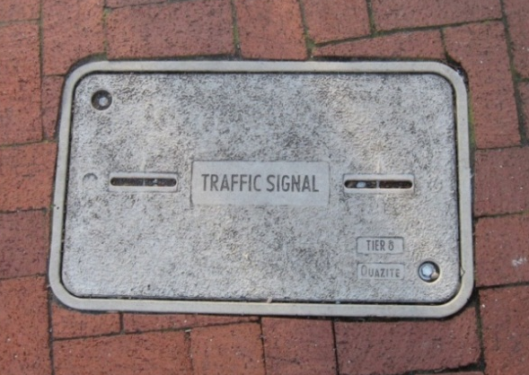
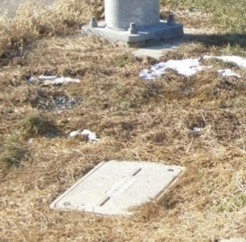
Junction Boxes
Junction Boxes
  Description: Watertight boxes of various materials, gasketed lid held down with stainless steel screws
  Use: The junction box is used as an access to conduit and wire

Slide 46
Terminal Blocks
Terminal Blocks
  Description: UL-listed with twelve sets minimum to two terminals suitable for the applicable wire size
  Use: For terminating wires/cables in signal pole or cabinet

Slide 47
Loop Feeder Cable
Loop Feeder Cable
  Description: Polyethylene jacketed, shielded cable with two twisted No. 14 AWG wires and bare tinned copper drain wire or No. 14 AWG wires wrapped with mylar tape
  Use: Connects pairs of loop wires to controller, splice only at the junction box nearest the loop wires

Slide 48
Loop Splice
Loop Splice
  Description: Two-piece plastic enclosure flooded with silicon grease
  Use: Used to connect loop feeder and loop wire (splice point)

Slide 49
Loop Wire (XHHW/DUCT)
Loop Wire (XHHW/DUCT)
  Description: Stranded copper conductor, with crosslinked polyethylene insulation, No. 14 AWG wire
  Use: Used to detect vehicles

Slide 50
Traffic Signal Specific Materials
Manual Section 4.8
The following sections describe a variety of the commonly used traffic signal specific materials used on traffic signal projects
The list is not all-inclusive and additional materials may be used

Slide 51
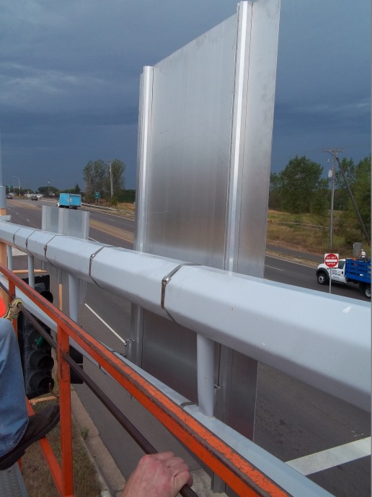
Aluminum Sign
Aluminum Sign Mounting Framework
  Description: An aluminum assembly for mounting signs on a mast arm and spanwire installations
  Use: To attach signs to a mast arm or span wire

Slide 52
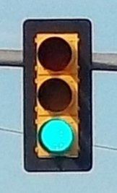
Backplates
Backplates
  Description: Aluminum sheet powder-coated flat black louvered or black polycarbonate attached with stainless steel screws and washers with reflective sheeting along the edge
  Use: Shield around vehicle signal to provide a contrast to the background

Slide 53
Eyebolt, Turnbuckle, Strandvise
Eyebolt, Turnbuckle, Strandvise
  Description: Hardware for attaching spanwire installations to strain poles
  Use: Used to hang the messenger cable (cable above signal heads

Slide 54
6-pair Interconnect Cable
6-pair Interconnect Cable
  Description: Shielded cable containing 6+ twisted pairs of No. 19 AWG wires
  Use: For communication between traffic signal controllers

Slide 55

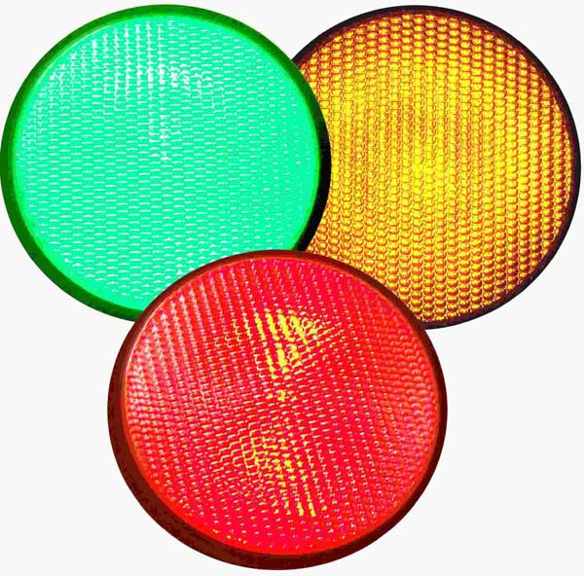
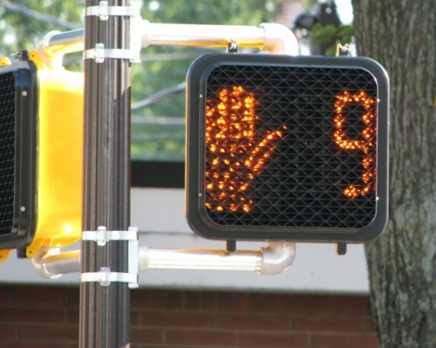
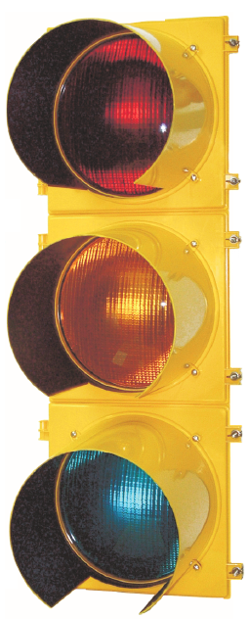
LED Modules (Vehicle & Ped)
LED Modules (Vehicle & Ped)
  Description: Light Emitting Diode (LED) Unit which replaces incandescent bulbs in signal heads and pedestrian heads
  Use: To illuminate vehicle and pedestrian signals
 | Section 1104 of Publication 408 indicates that the following must be Bulletin 15 approved: LED Vehicular and Pedestrian Signal Modules LED Countdown Pedestrian Signal Modules LED Lane-Use Traffic Control Signal Heads

Slide 56
Messenger Cable
Messenger Cable
  Description: Bare steel cable comprised of seven strands of galvanized wire
  Use: Supports control cables, signal heads and signs on a spanwire installation

Slide 57
Meter Base
Meter Base
  Description: Socket into which the power company’s meter is installed.
  Use: For power companies to meter power

Slide 58
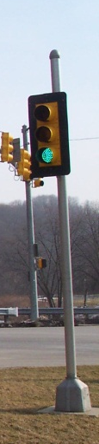
Pedestal (Pedestrian Signal)
Pedestal (Pedestrian Signal)
  Description: Galvanized steel pipe mounted on a cast aluminum or galvanized cast iron base
  Use: Freestanding pole for mounting of pedestrian signals and/or traffic signal indications

Slide 59
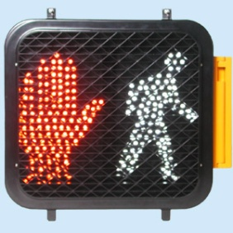
Pedestrian Signal
Pedestrian Signal
  Description: Pole mounted signals. Aluminum powder-coated black or black polycarbonate with stainless steel hardware
  Use: To indicate walk/don’t walk pedestrian phases at marked crosswalks

Slide 60
Pedestrian Signal Mount
Pedestrian Signal Mount
  Description: Swing open clam shell compartment
  Use: To connect pedestrian signal to pole, with wire terminals

Slide 61
Preformed Loops
Preformed Loops
  Description: Four turns of No. 14 AWG XHHW or No. 16 AWG TFFN wire encased in either schedule 40 PVC or rubber hydraulic hose totally filled with sealant
  Use: Used to detect vehicles in thin, poor pavement or concrete bridge decks

Slide 62
PTR Signs
PTR Signs
  Description: Flat black, painted, aluminum alloy case with part-time legend when lit
  Use: To indicate part time restrictions when turned on.

Slide 63
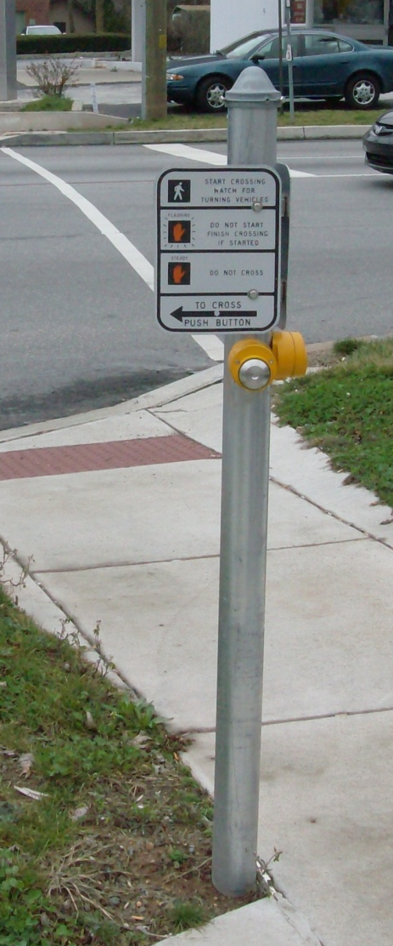
Push Button
Push Button
  Description: A tamper and weatherproof assembly with pushbutton contacts, entirely insulated from the housing and buttons
  Use: For pedestrians to request the walk phase

Slide 64
Riser Frames
Riser Frames
  Description: One piece welded construction for newer installations; two-piece bolt together for retro-fit
  Use: To raise the controller cabinet from the foundation 8

Slide 65
Service Cabinet
Service Cabinet
  Description: Base mounted service cabinet with integral meter base
  Use: Used to provide fused electrical service

Slide 66
Spanwire Hanger
Spanwire Hanger
  Description: A fitting of cast bronze that attaches to the messenger cable with two “U” bolts
  Use: To mount vehicle signal and signs on span wires

Slide 67
Tether & Stabilizer Cable
Tether & Stabilizer Cable
  Description: One-quarter inch galvanized steel cable comprised of seven strands of galvanized wire
  Use: Attached at the bottom of equipment to stabilize and prevent wind movement

Slide 68
Tether Clamp
Tether Clamp
  Description: Fitting on bottom of span mounted signal or sign constructed of 1½ inch galvanized steel pipe or galvanized metal conduit with plate welded on bottom, tether wire keeper bolted to plate
  Use: To attach tether cable to vehicle signals and signs

Slide 69
4.8 Traffic Signal Specific Materials
Tri-Stud Adaptors
  Description: Fitting of cast aluminum with steel insert, powder-coated as per spec
  Use: To mount signals and signs to plumbizer or span wire hanger

Slide 70
Vehicle Signal Bracket (Adj.)
Vehicle Signal Bracket (Adj.)
  Extruded aluminum assembly that is adjustable
  Use: To mount vehicle signals and signs on a mast arm

Slide 71
Vehicle Signal Visor
Vehicle Signal Visor
  Description: Aluminum powder-coated black or black polycarbonate open at bottom standard (tunnel)
  Use: On all signal heads to direct the illumination to the motorist

Slide 72
Vehicle Signals
Vehicle Signals
  Description: Aluminum powder-coated black or black polycarbonate
  Use: To direct vehicles at intersections

Slide 73
Traffic Signal Controller Materials
Manual Section 4.9
The following sections describe a variety of the commonly used traffic signal controller materials used on traffic signal projects
The list is not all-inclusive and additional materials may be used

Slide 74
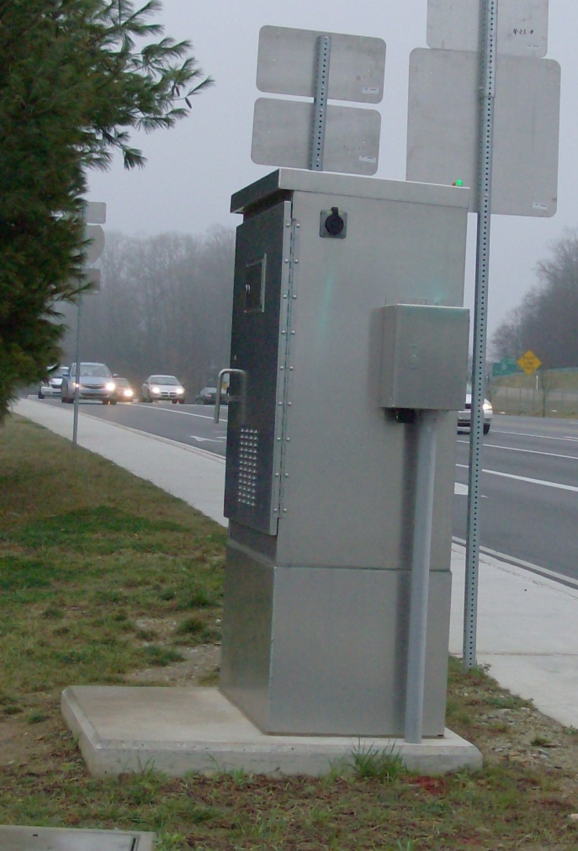
Controller Cabinet
Controller Cabinet
  Description: Ground mounted and pole mounted signal cabinets.
  Use: Houses the equipment to run the traffic signal

Slide 75
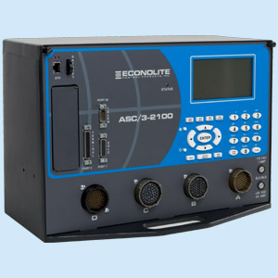
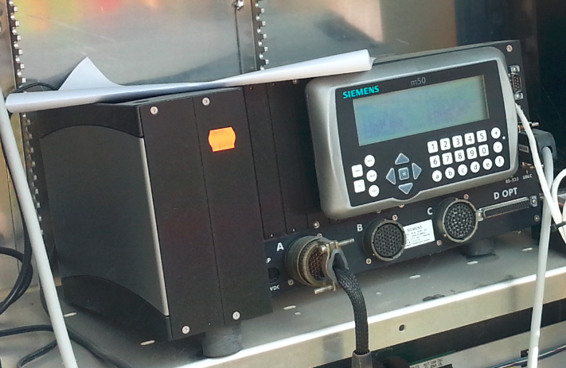
Controller
Controller
  Description: NEMA or 170 controller unit
  Use: The brains of the traffic signal

Slide 76
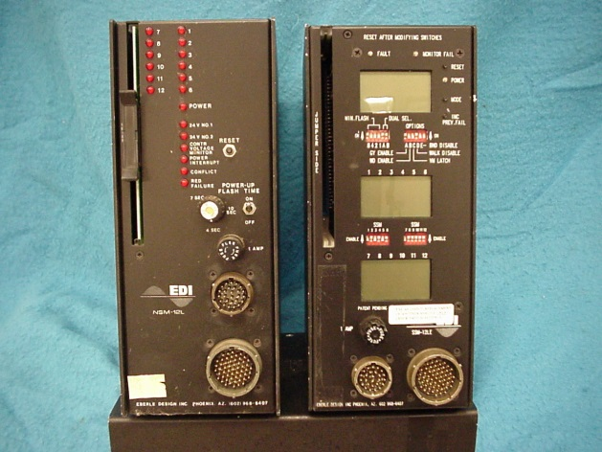
Conflict Monitor
Conflict Monitor
  Description: NEMA or 170 as indicated in contract documents and Publication 408
  Use: Monitors the green indications (vehicle) and walk indications (pedestrian) to ensure conflicting movements are not serviced at the same time

Slide 77
Load Switch
Load Switch
  Description: NEMA or 170 as indicated in contract documents and Publication 408
  Use: Powers the signal and pedestrian indications in the field

Slide 78
Flasher
Flasher
  Description: NEMA or 170 as indicated in contract documents and Publication 408
  Use: Powers the signal indications when in flash mode

Slide 79
Detector Amplifier
Detector Amplifier
  Description: NEMA or 170 as indicated in contract documents and Publication 408
  Use: A device that is capable of detecting the changes in the electrical energy produced by a sensor

Slide 80
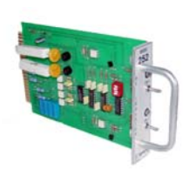
Isolator (DC and AC)
Isolator (DC and AC)
  Description: NEMA or 170 as indicated in contract documents and Publication 408
  Use: Detects when a pedestrian pushes a button or when a train is approaching and puts a “call” into the controller

Slide 81
Modem
Modem
  Description: NEMA or 170 as indicated in contract documents and Publication 408
  Use: Provides communications between traffic signals and/or to the central traffic signal operations office

Slide 82
Relay (FTR)
Relay (FTR)
  Description: Model 430
  Use: Switches the power from the load switches (normal operation) to the flashers (flash operation)

Slide 83
Preemption Interface (Cabinet)
Preemption Interface (Cabinet)
  Description: Several models acceptable for use
  Use: Detects an emergency vehicle (that is using a preemption emitter in their vehicle) and puts a “call” into the controller

Slide 84
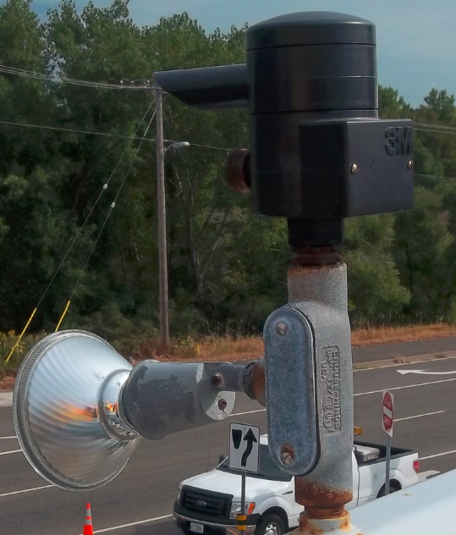
Preemption Detector (Field)
Preemption Detector (Field)
  Description: Several models acceptable for use
  Use: Detects an emergency vehicle (that is using a preemption emitter in their vehicle) which is recognized by the preemption interface in the cabinet

Slide 85
GPS Time Sync Module
GPS Time Sync Module
  Description: Per Publication 408 Section 1104
  Use: To keep accurate time in the traffic signal controller

Slide 86
Video & Radar Detection Device
Video & Radar Detection Device
  Description: Camera mounted to mast arm or luminaire arm
  Use: Alternative detection mode for vehicles

Slide 87
Audible Pedestrian Signal
Audible Pedestrian Signal
  Description: Audio unit mounted near signal head and/or pushbutton.
  Use: Provides sight impaired pedestrians’ audible information regarding the pedestrian phases

Slide 88
Battery Back-up System
Battery Back-up System
  Description: Uninterrupted Power Supply (UPS)
  Use: Provides power to the traffic signal when commercial power is out

Slide 89
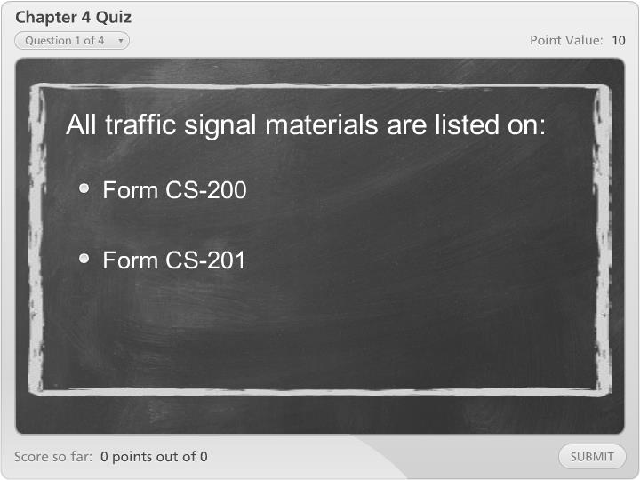
Chapter 4 Quiz

Slide 90
Module 4 Completion
You have now completed Module 4, Materials and Products
To review any section in this module, use the “Outline” on the left
Up next is Module 5, Traffic Signal Construction
It is suggested that you complete Module 5 before proceeding to the additional modules

Slide 91
Remaining Modules
The remaining modules include:
  Module 5: Traffic Signal Construction
  Module 6: Traffic Signal Inspection
Return to the PennDOT Technical Training Calendar to select Module 5

